Slide 1
Mongodb scans
Aswin p p

Slide 2
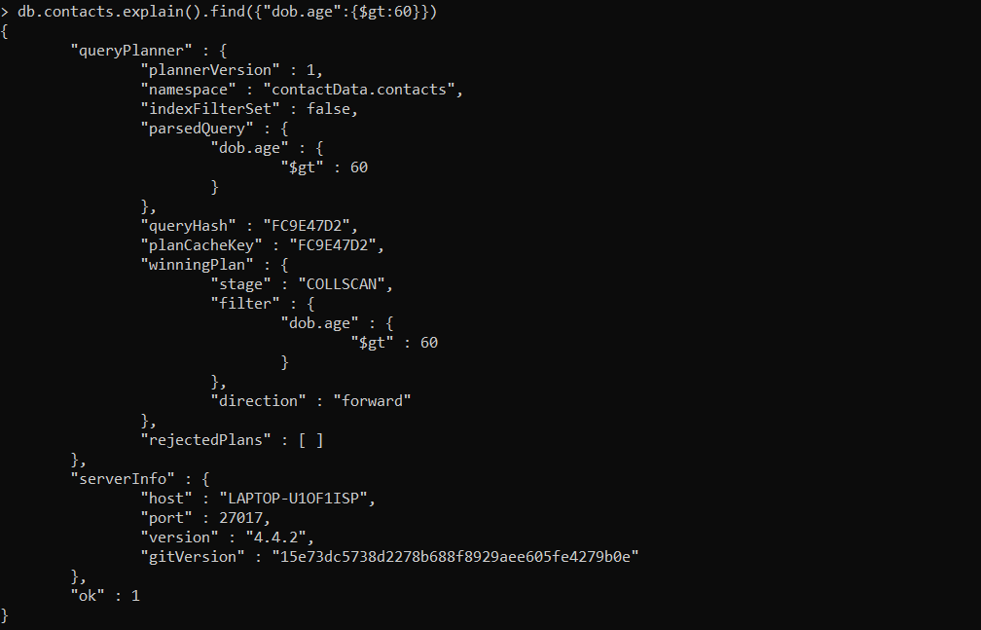
Collection scan

Slide 3
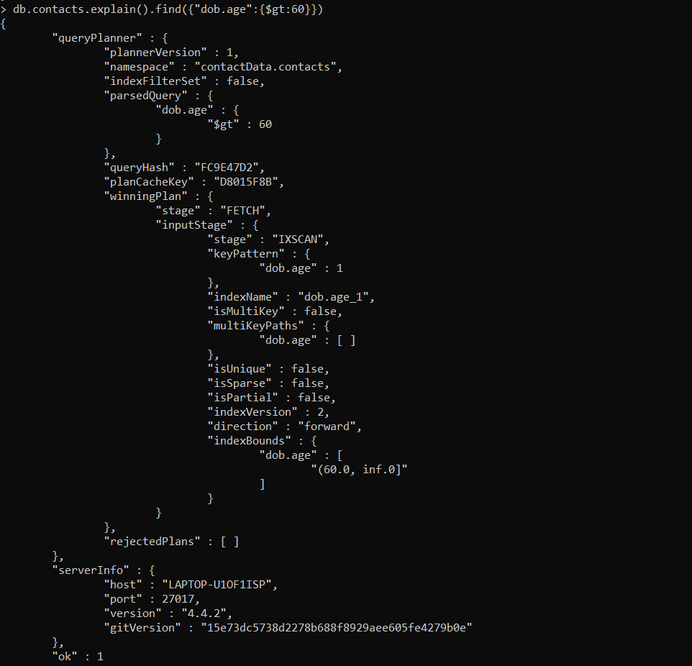
IXSCAN

